Slide 1
Messaging services at Nedap
Mark Banierink, Martijn Slot en Anne-Greeth van Herwijnen

Slide 2
Assignment
Message Services
At the departments
Observations

Slide 3




Messaging services

Slide 4
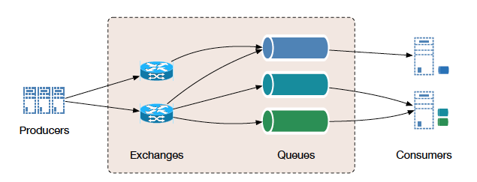
RabbitMQ
Stores in memory
Exchanges and Queues
Persistence is a setting

Slide 5
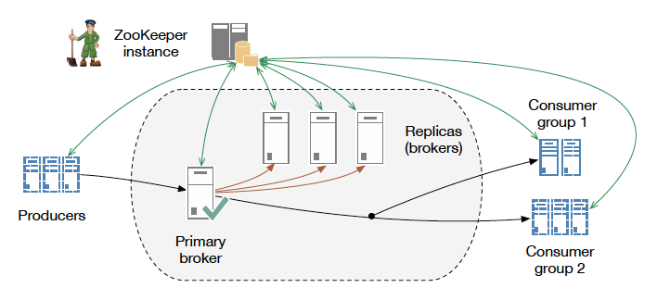
Kafka
Stores on disk
Needs ZooKeeper
Persistence is guaranteed

Slide 6
Mosquitto

Slide 7
Faye

Slide 8
Departments

Slide 9

Retail

Slide 10
Message services at
Retail
RabbitMQ -> Legacy and it works
Kafka -> Allows for replay of events and load balancing

Slide 11

Staffing Solutions

Slide 12
Message services at Staffing Solutions
RabbitMQ -> Legacy, only for some DB related jobs
Kafka -> Between applications and microservices
Faye -> Between users

Slide 13

Identification Systems

Slide 14
Message services at Identification Systems
Mosquitto
WAT WILLEN WE HIER?

Slide 15

Light Controls

Slide 16
Message services at
Light Controls
WAT WILLEN WE HIER?

Slide 17

Observations

Slide 18
Observations
Not necessary
Support by SteppingStone
Change is difficult

Slide 19
The End
Don’t shoot the messenger!

